Slide 1
Introduction to Embedded Systems.
Shriram K Vasudevan
20/05/2016
Session – 1
Faculty Development Programme.

Slide 2
Agenda
Introduction to Embedded Systems
Characteristics of Embedded Systems
Components of Embedded Systems - OS Will come as a part
OS – Heart of any system
Difference between RTOS and OS.
Queries.

Slide 3
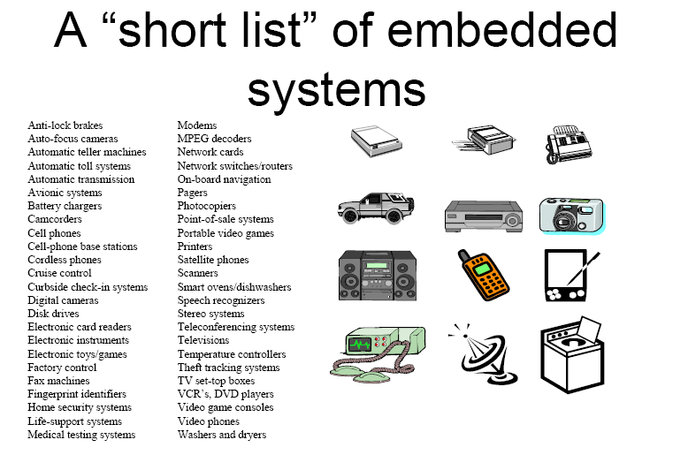
Lets define.
What is a System ?
Simple. Anyone can say! Input + processing + output.
What is embedded system?
Computing system other than desktop computers
An embedded system is the one that has computer hardware with software embedded in it as one of its most important components
It is any device that includes a programmable computer but is not itself intended to be a general purpose computer.
Example will make life easier! Air conditioner!

Slide 4
Characteristics of embedded systems
All Embedded Systems have certain common characteristics. They can be listed as follows:
Single Functioned
Tightly Constraint
Real Time & Reactive
Complex Algorithms
User Interface
Multi rate
Manufacturing Cost
Power
Let’s see about all these in a detail.

Slide 5
A Diagrammatic representation of Embedded Systems Architecture – Presented here!
TYPICALLY : COMPARE, SIGNAL PROCESS (VOICE/PROCESS)
A
C
Q
U
I
R
E
A
N
A
L
Y
Z
E
CO
N
T
R
O
L
D
I
S
P
L
A
Y
ACTUATORS
DISPLAYS
ALARMS
INDICATORS
OUTPUT
SENSORS
KEY
SWITCHES
INPUT

Slide 6
A Diagrammatic representation of Embedded Systems Architecture – Presented here!
Sensors
KEY, SWITCHES, INPUTS
Compare Signal process
(Voice Image)
ACQUIRE
Wired / Wireless/ Mobile
ANALYZE
(PROCESS)
Communicate
ACTUATORS, DISPLAYS, ALARMS, INDICATORS,
OUTPUTS
DISPLAY
CONTROL

Slide 7
Challenges in Embedded System Design
There are many challenges in designing an embedded system. Let us discuss them as follows in detail:
How much hardware do we need?
How do we meet deadlines?
How do we minimize power consumption?
How do we design for upgradeability?
Does it really work?
How does the nature of ES make their design more difficult?
Does it optimize the design metrics?
Let’s pick each of the above challenges and discuss!

Slide 8
Conflicting requirements
Metrics usually compete one with another, improving one will affect Other metric.
For example if we reduce size, it may affect performance.

Slide 9
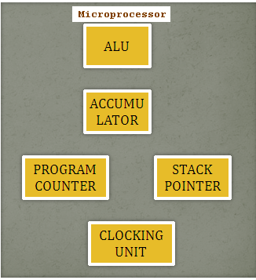
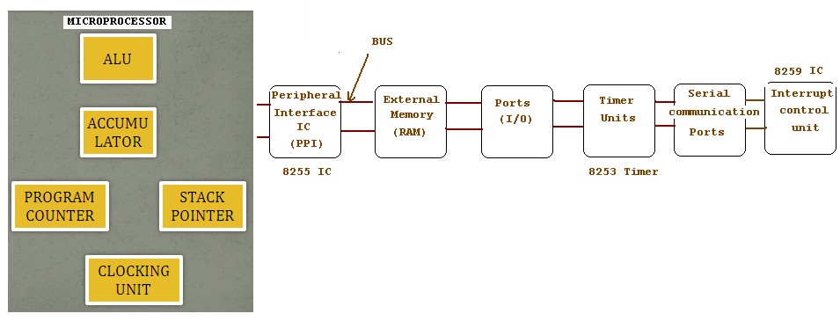
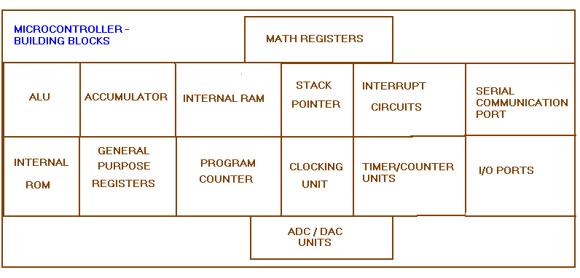
MUP Vs. MUC
Micro-Controller.

Slide 10
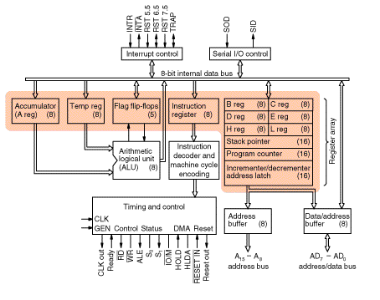
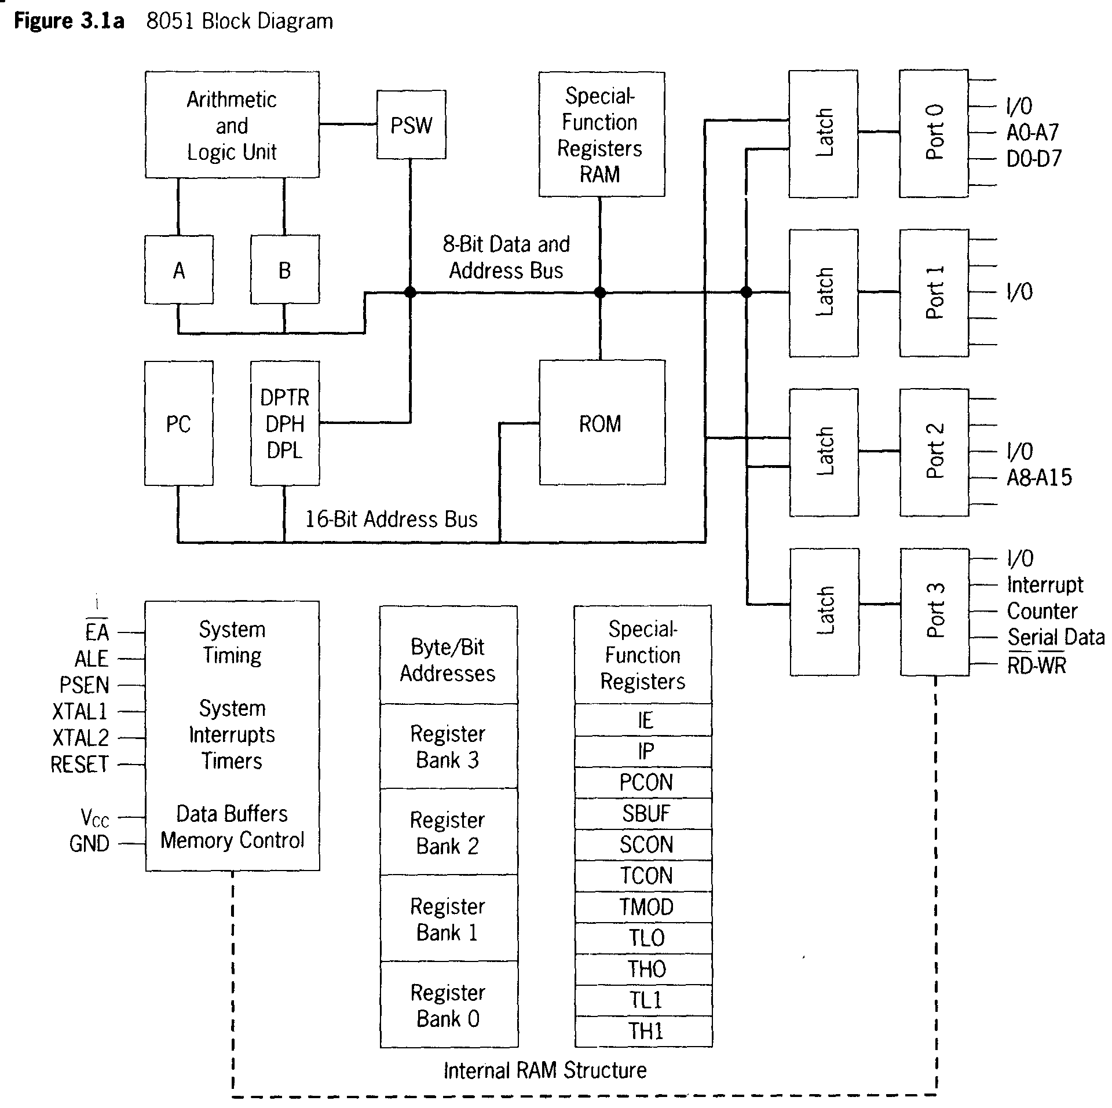
Mup vs. MUC

Slide 11
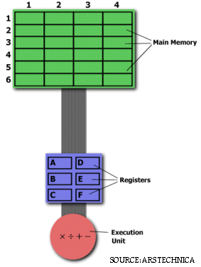
Risc Vs. CISC
On the right is a diagram representing the storage scheme for a generic computer.
The main memory is divided into locations numbered from (row) 1: (column) 1 to (row) 6: (column) 4.
The execution unit is responsible for carrying out all computations.
However, the execution unit can only operate on data that has been loaded into one of the six registers (A, B, C, D, E, or F).
Let's say we want to find the product of two numbers - one stored in location 2:3 and another stored in location 5:2 - and then store the product back in the location 2:3.

Slide 12
Contd., THE CISC APPROACH
The primary goal of CISC architecture is to complete a task in as few lines of assembly as possible.
This is achieved by building processor hardware that is capable of understanding and executing a series of operations. For this particular task, a CISC processor would come prepared with a specific instruction (we'll call it "MULT")
MULT 2:3, 5:2
MULT is what is known as a "complex instruction.“
It operates directly on the computer's memory banks and does not require the programmer to explicitly call any loading or storing functions.
It closely resembles a command in a higher level language
When executed, this instruction loads the two values into separate registers, multiplies the operands in the execution unit, and then stores the product in the appropriate register. Thus, the entire task of multiplying two numbers can be completed with one instruction:
Advantages:
Because the length of the code is relatively short, very little RAM is required to store instructions.
The emphasis is put on building complex instructions directly into the hardware

Slide 13
Contd., The RISC Approach
RISC processors only use simple instructions that can be executed within one clock cycle.
Thus, the "MULT" command described above could be divided into three separate commands:
"LOAD," which moves data from the memory bank to a register
"PROD," which finds the product of two operands located within the registers
"STORE," which moves data from a register to the memory banks.
LOAD A, 2:3 LOAD B, 5:2 PROD A, B STORE 2:3, A
Is this less efficient?
More RAM is needed to store the assembly level instructions.
The compiler must also perform more work to convert a high-level language statement into code of this form.
Not actually, there are benefits!
These RISC "reduced instructions" require less transistors of hardware space than the
complex instructions, leaving more room for
general purpose registers.
Because all of the instructions execute in a
uniform amount of time (i.e. one clock),
pipelining is possible
Notes:
more RAM is needed to store the assembly level instructions. The compiler must also perform more work to convert a high-level language statement into code of this form.

Slide 14
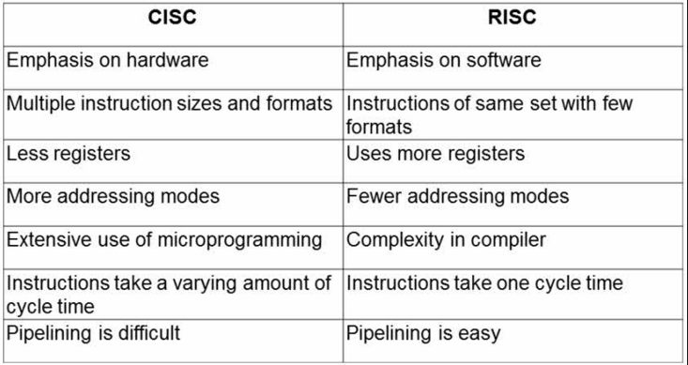
So?

Slide 15
Summary
System
Embedded System
Characteristics
Challenges
CISC Vs. RISC

